Slide 1
B.Tech – CSE – Sem. 3 18CSS201J – ANALOG AND DIGITAL ELECTRONICS (Regulations 2018)
UNIT 4
Session-7( Analysis of synchronous sequential circuits: State Equation, State Table, State Diagram)

Slide 2


UNIT 4: SEQUENTIAL CIRCUITS
Sequential circuits,
Latch and Flip-Flops,
RS Flip-Flops,
Gated Flip-Flops,
Edge-triggered RS FLIP-FLOP,
Edge-triggered D FLIP-FLOPs,
Edge-triggered T FLIP-FLOPs,
Edge-triggered JK FLIPFLOPs,
JK Master-slave FLIP-FLOP,
Analysis of Synchronous Sequential Circuit,
State Equation, State table, State Diagram,
Synthesis of sequential circuit using Flip-Flops,
Asynchronous sequential circuit,
Transition Table, State table ,
Flow table,
Analysis of asynchronous sequential circuits

Slide 3
Analysis of Clocked Sequential Circuits
The analysis of a sequential circuit consists of obtaining a table or a diagram for the time sequence of inputs, outputs, and internal states. It is also possible to write Boolean expressions that describe the behavior of the sequential circuit. These expressions must include the necessary time sequence, either directly or indirectly.

Slide 4
State Equations
The behavior of a clocked sequential circuit can be described algebraically by means of state equations. A state equation specifies the next state as a function of the present state and inputs. Consider the sequential circuit. It consists of two D flip-flops A and B, an input x and an output y.

Slide 5
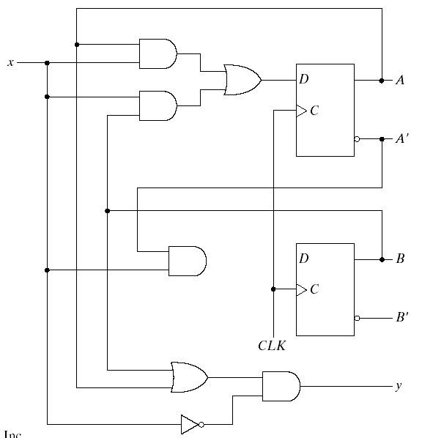













Fig.5-15 Example of Sequential Circuit

Slide 6

























Slide 7
State Equation
A(t+1) = A(t) x(t) + B(t) x(t)
B(t+1) = A`(t) x(t)
A state equation is an algebraic expression that specifies the condition for a flip-flop state transition. The left side of the equation with (t+1) denotes the next state of the flip-flop one clock edge later. The right side of the equation is Boolean expression that specifies the present state and input conditions that make the next state equal to 1.
Y(t) = (A(t) + B(t)) x(t)`

Slide 8
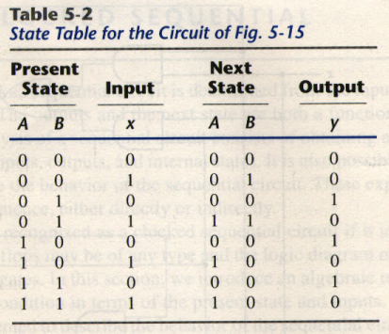
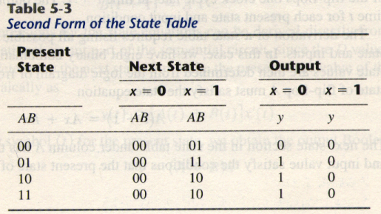
State Table
The time sequence of inputs, outputs, and flip-flop states can be enumerated in a state table (sometimes called transition table).

Slide 9
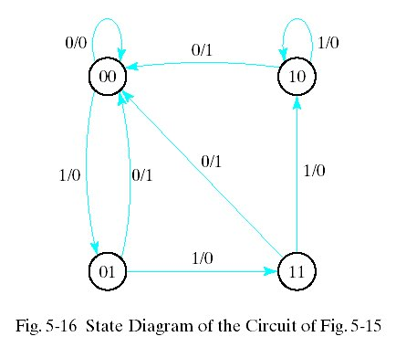
State Diagram
The information available in a state table can be represented graphically in the form of a state diagram. In this type of diagram, a state is represented by a circle, and the transitions between states are indicated by directed lines connecting the circles.
1/0 : means input =1
output=0

Slide 10
Flip-Flop Input Equations
The part of the combinational circuit that generates external outputs is descirbed algebraically by a set of Boolean functions called output equations. The part of the circuit that generates the inputs to flip-flops is described algebraically by a set of Boolean functions called flip-flop input equations. The sequential circuit of consists of two D flip-flops A and B, an input x, and an output y. The logic diagram of the circuit can be expressed algebraically with two flip-flop input equations and an output equation:
DA = Ax + Bx
DB = A`x
y = (A + B)x`

Slide 11
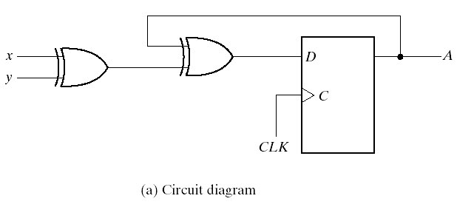
Analysis with D Flip-Flop
The circuit we want to analyze is described by the input equation DA = A x y
The DA symbol implies a D flip-flop with output A. The x and y variables are the inputs to the circuit. No output equations are given, so the output is implied to come from the output of the flip-flop.

Slide 12
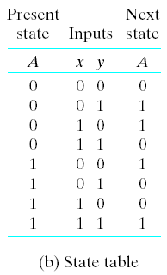
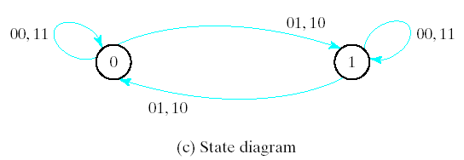
Analysis with D Flip-Flop
The binary numbers under Axy are listed from 000 through 111 as shown in Fig. 5-17(b). The next state values are obtained from the state equation A(t+1) = A x y
The state diagram consists of two circles-one for each state as shown in Fig. 5-17(c)

Slide 13
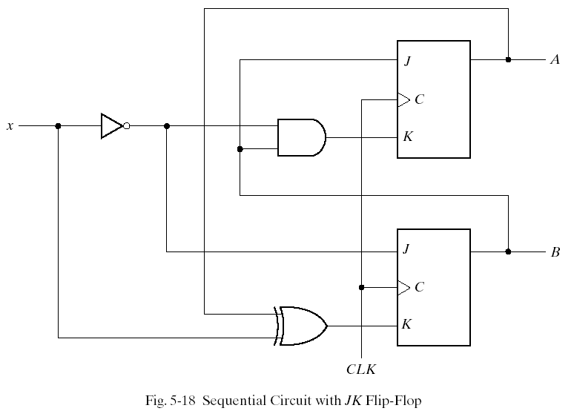
Analysis with JK Flip-Flops

Slide 14
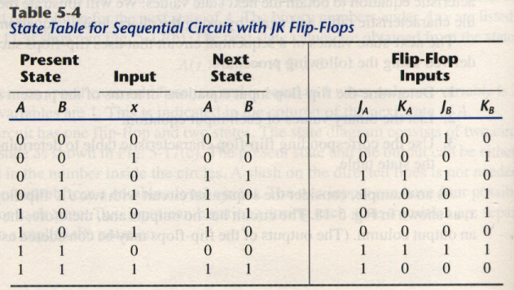
Analysis with JK Flip-Flop
The circuit can be specified by the flip-flop input equations
JA = B KA = Bx`
JB = x` KB = A`x + Ax` = A x

Slide 15
Analysis with JK Flip-Flops
A(t + 1) = JA` + K`A
B(t + 1) = JB` + K`B
Substituting the values of JA and KA from the input equations, we obtain the state equation for A:
A(t + 1) = BA` + (Bx`)`A = A`B + AB` +Ax
The state equation provides the bit values for the column under next state of A in the state table. Similarly, the state equation for flip-flop B can be derived from the characteristic equation by substituting the values of JB and KB:
B(t + 1) = x`B` + (A x)`B = B`x` + ABx + A`Bx`

Slide 16
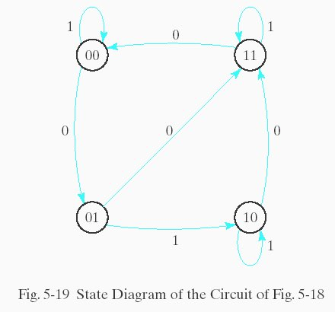
Analysis with JK Flip-Flops
The state diagram of the sequential circuit is shown in Fig. 5-19.

Slide 17
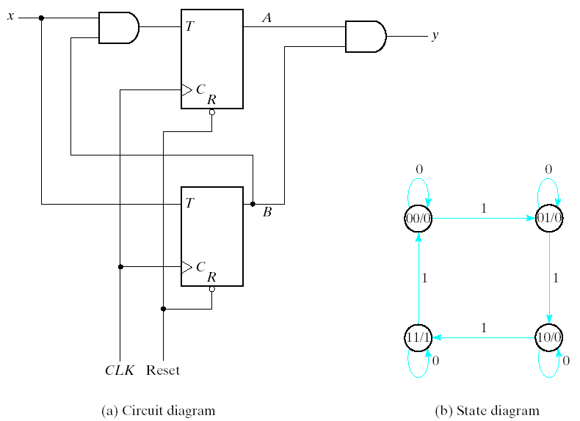
Analysis With T Flip-Flops
Characteristic equation
Q(t + 1) = T Q = T`Q + TQ`
00/0 : means
state is 00
output is 0

Slide 18
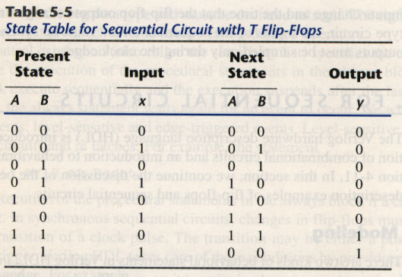
Analysis With T Flip-Flops
Consider the sequential circuit shown in Fig. 5-20. It has two flip-flops A and B, one input x, and one output y. It can be described algebraically by two input equations and an output equation:
TA = Bx
TB = x
y = AB
A(t+1)=(Bx)’A+(Bx)A’
=AB’+Ax’+A’Bx
B(t+1)=x⊕B
Use present state
as inputs

